Slide 1
Spikes
DATAFLOW in OEP
Wireless
Data
Spike
Sorter
Event
Broadcaster
Digital Data
Ecube Box
Control
OEP
Spikes
Python based online
Data: Analog, Digital
?
Wireless Logger
Data: Analog, Digital
USB
?
White Matter PC
Is wireless data coming into eCube Box from transceiver?

Slide 2
Notes
Install Server Node
Understand the difference between server node and server control.
Verify the wireless data saved in whitematter PC.
Verify if packets are broadcasted after adding spike sorter in OEP.
Once tested the wireless routine we could use the HS tester with wired system for all the debugging purposes.
Potential issue: Aligning the digital control and spikes in python-based program.

Slide 3
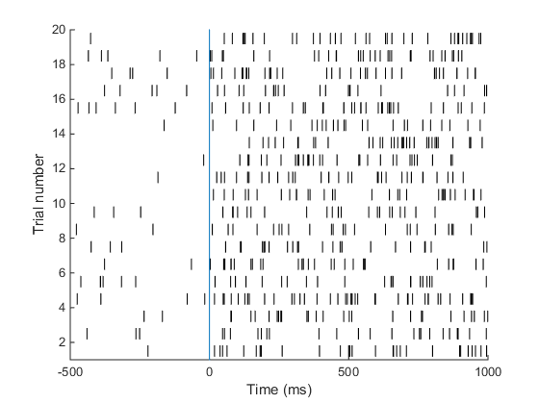
Online Plots- Minimum Req.
SAME
DIFFERENT

Slide 4
Online Plots- Step-2
Channel-1
Channel-2
AA
BB
AA
BB
SAME
SAME
BA
AB
BA
AB
DIFF
DIFF

Slide 5
Testing stages
ML event checking
Check if ML events are readable using the Python scripts, and save a file.
Compare all event codes in a few trials between the eCube file & Python file.
Create a window in which you can plot the basic events raster (sample on, sample off, test on, test off, response, reward) for a given set of condition numbers, across many repeats of that conditions.
Neural data checking
Check if neural data is readable using the Python scripts and save a file.
Compare neural data between the eCube file & Python file.
Plot spikes in a given trial on the same window as the ML events.
Create final online plot.
System ON sequence
FILL IN
- Netcam watchtower connect
- Start Python online plot program
To start recording of data --
Start recording on eCube OEP
HSW-PC start recording, Wireless OEP start streaming
Start behavioural task for monkey

Slide 6
Python code modification discussion : 9th Feb, 2021
Condition {0,1,3},
Spike Data
Time Axis-wrt Sample ON
Event Codes
Trial Que
Time
Start
End
Reps
1: Event
Q
2. Spike

